Slide 1
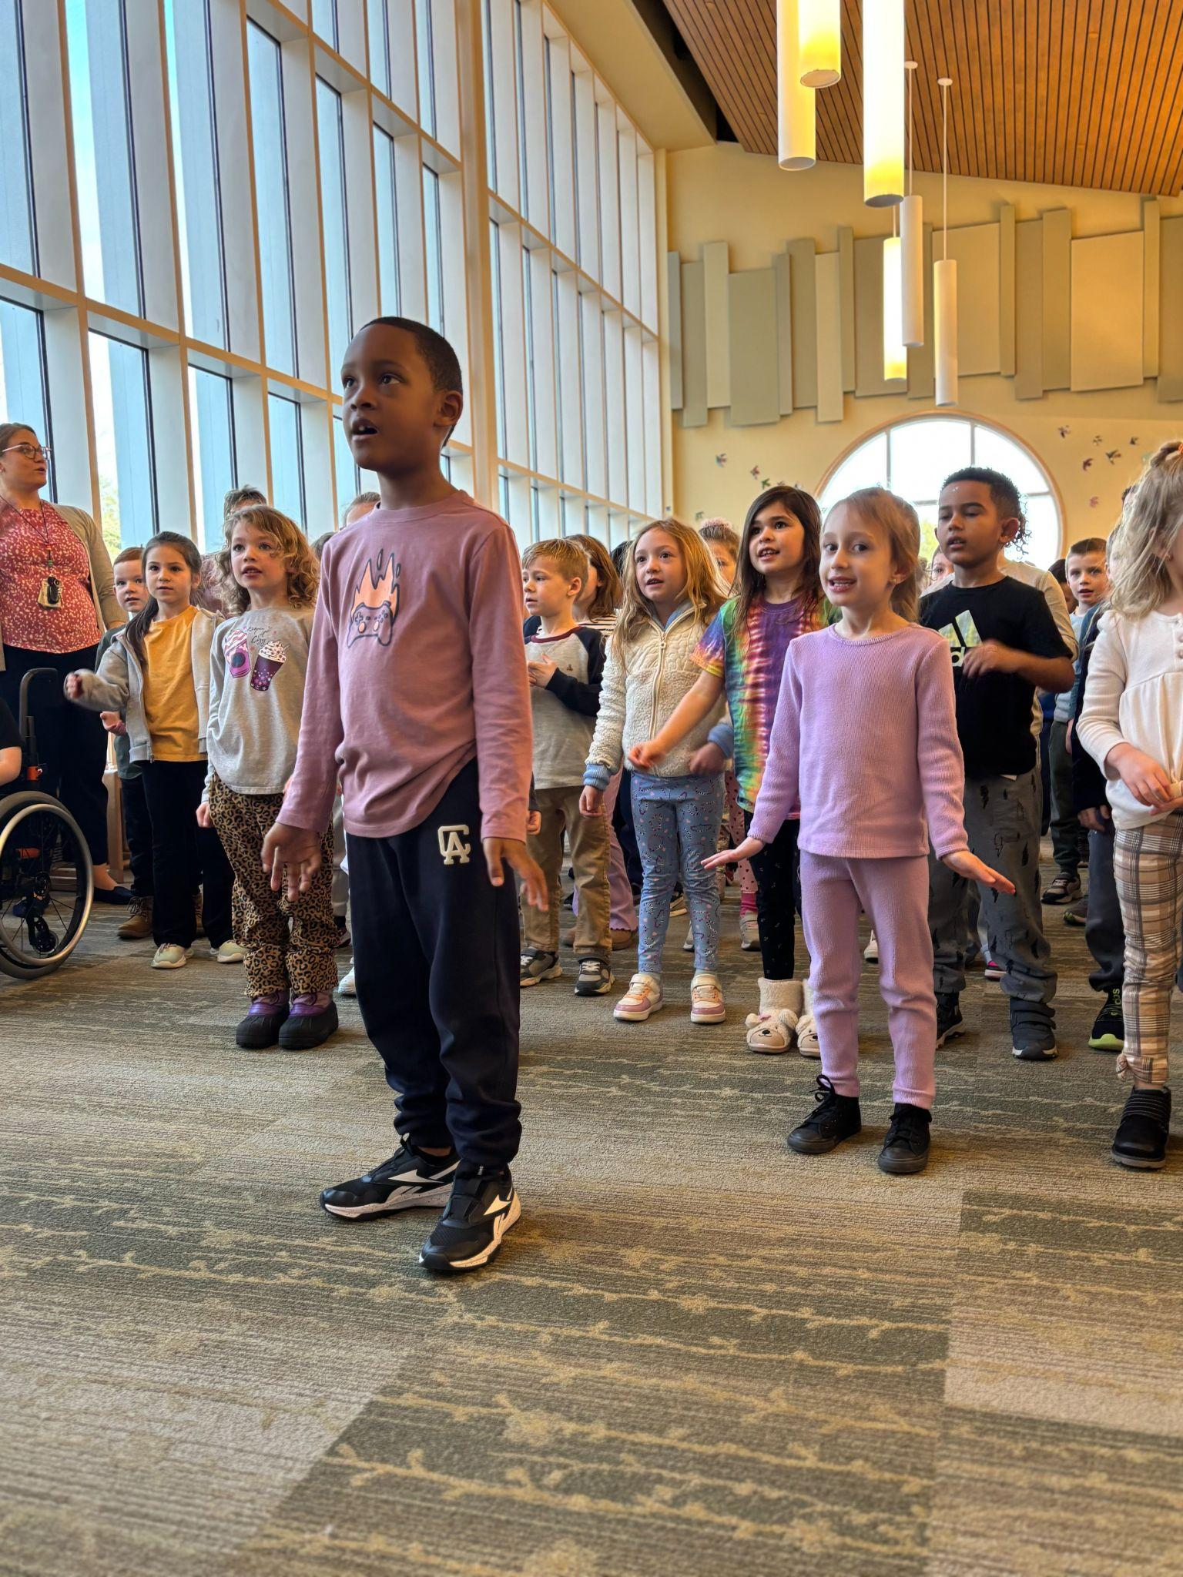

Georgetown Public Schools
FY27 Superintendent’s
Proposed Budget
Michael Cassidy
Dr. Margo Ferrick
February 12, 2026
Notes:
Margo

Slide 2
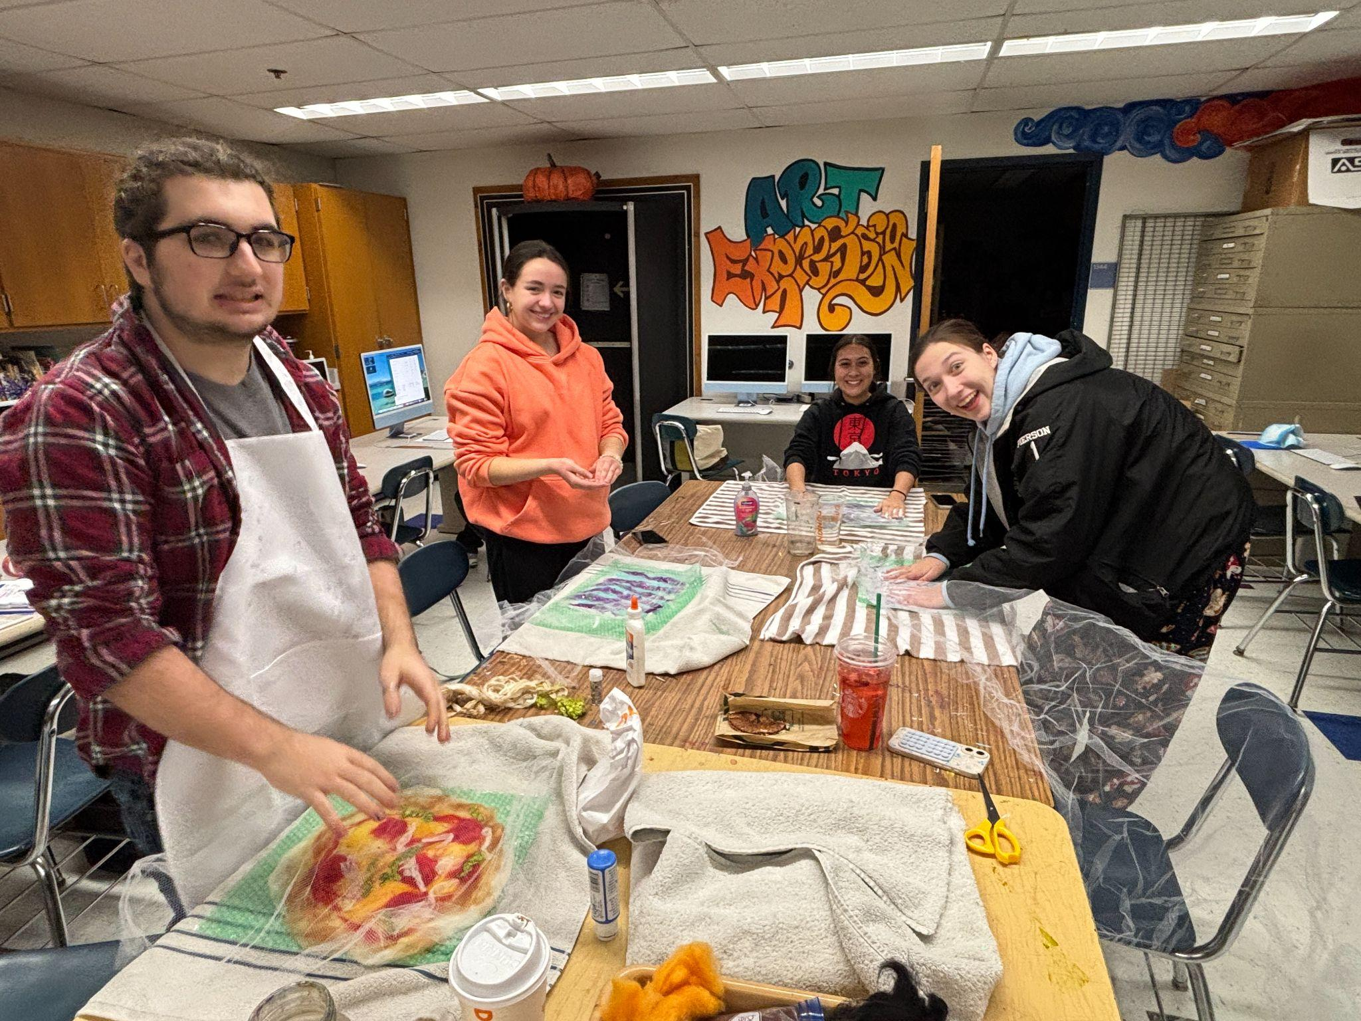

The Agenda
What We Stand For
Effects of FY26 Budget
FY27 Resources
The Budget Numbers & Impact
Notes:
Margo

Slide 3

Mission Statement
Strategic Priority:
Through holding high standards, the Georgetown Public School District is committed to providing a safe, welcoming, and inclusive environment that meets staff where they are professionally and students where they are academically and social-emotionally. Growth is supported by developing and building knowledge, skills, and competencies for resilient and productive community members.
Fortify Our Foundation
Develop consistent reliable systems and structures to prioritize community engagement, communication, and resources to ensure equitable access for all students
2025-2030
Strategic
Plan
GPS Action Step
Thoughtful appropriations of human, fiscal, and physical resources will be prioritized with an equity focus. The needs all students will be
Vision Statement
paramount and future planning will build upon the assets and strengths of the school department
ALL Georgetown students are understood as individuals, valued, and empowered to reach their potential in a safe, nurturing environment. By engaging and partnering with the community and equipping all staff with the needed knowledge, skills, and resources, Georgetown Public Schools will provide a comprehensive network of support and experiences that prepare students for success beyond high school.
Notes:
Margo

Slide 4

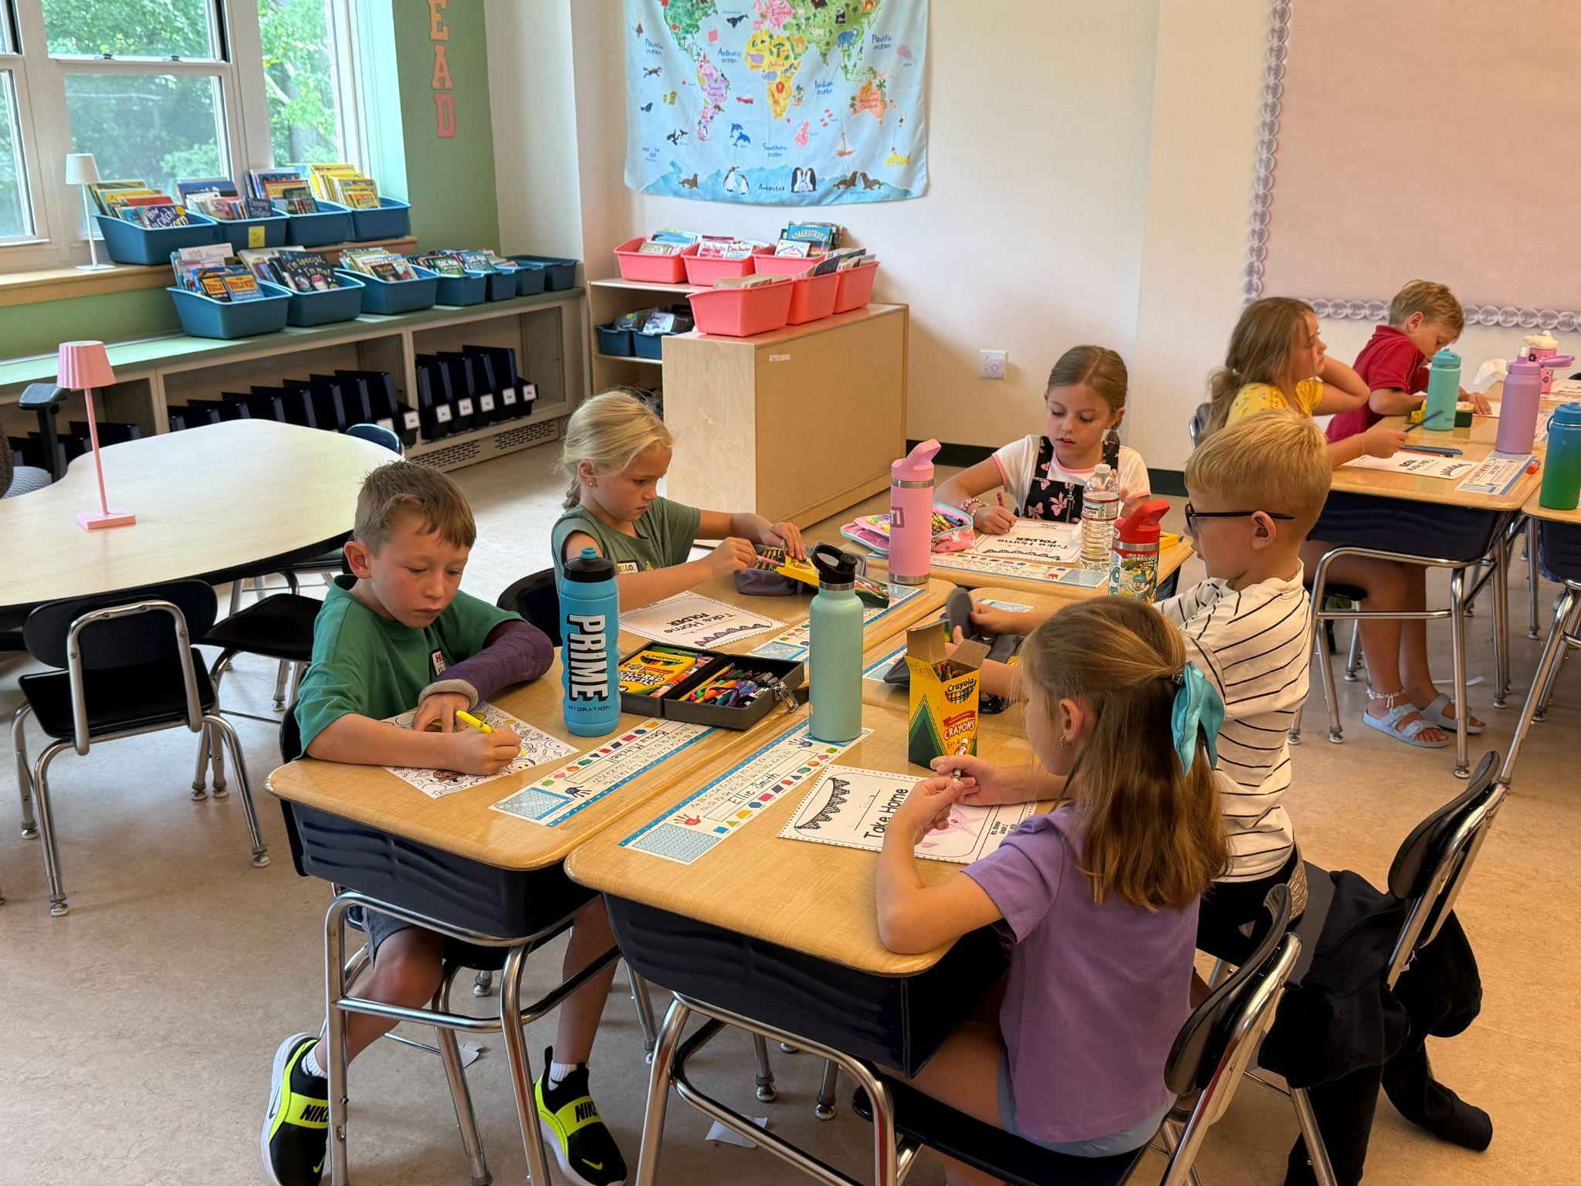
FY26 Impacts
Operations
Installation of additional security cameras in blind spots areas
Update School Security access system
Install first responders radio and cell phone repeaters at PBES
Purchase building based 2-way radios
Begin a replacement program for aging floor scrubbers & bathroom cleaning machines
In-district special education transportation
Technology
Purchase classroom Touchviews across the district
Tech Dept. staffing structure impacts help desk response time
Begin a replacement program for obsolete staff laptops
Improve building connectivity
Purchase Chromebooks for support staff to support student instruction
Begin cybersecurity initiative with the State
Curriculum & Instruction
i-Ready K-8 Benchmark assessments and personalized learning
Dibels parent report for Grade K-5
New Curriculum for
ELA, Grade 9-12
Biology, Chemistry, Physics and Environmental Science
Examining K-5 Math options
Professional development initiatives targeting literacy, math and science
Reading intervention and math support
Notes:
Margo

Slide 5
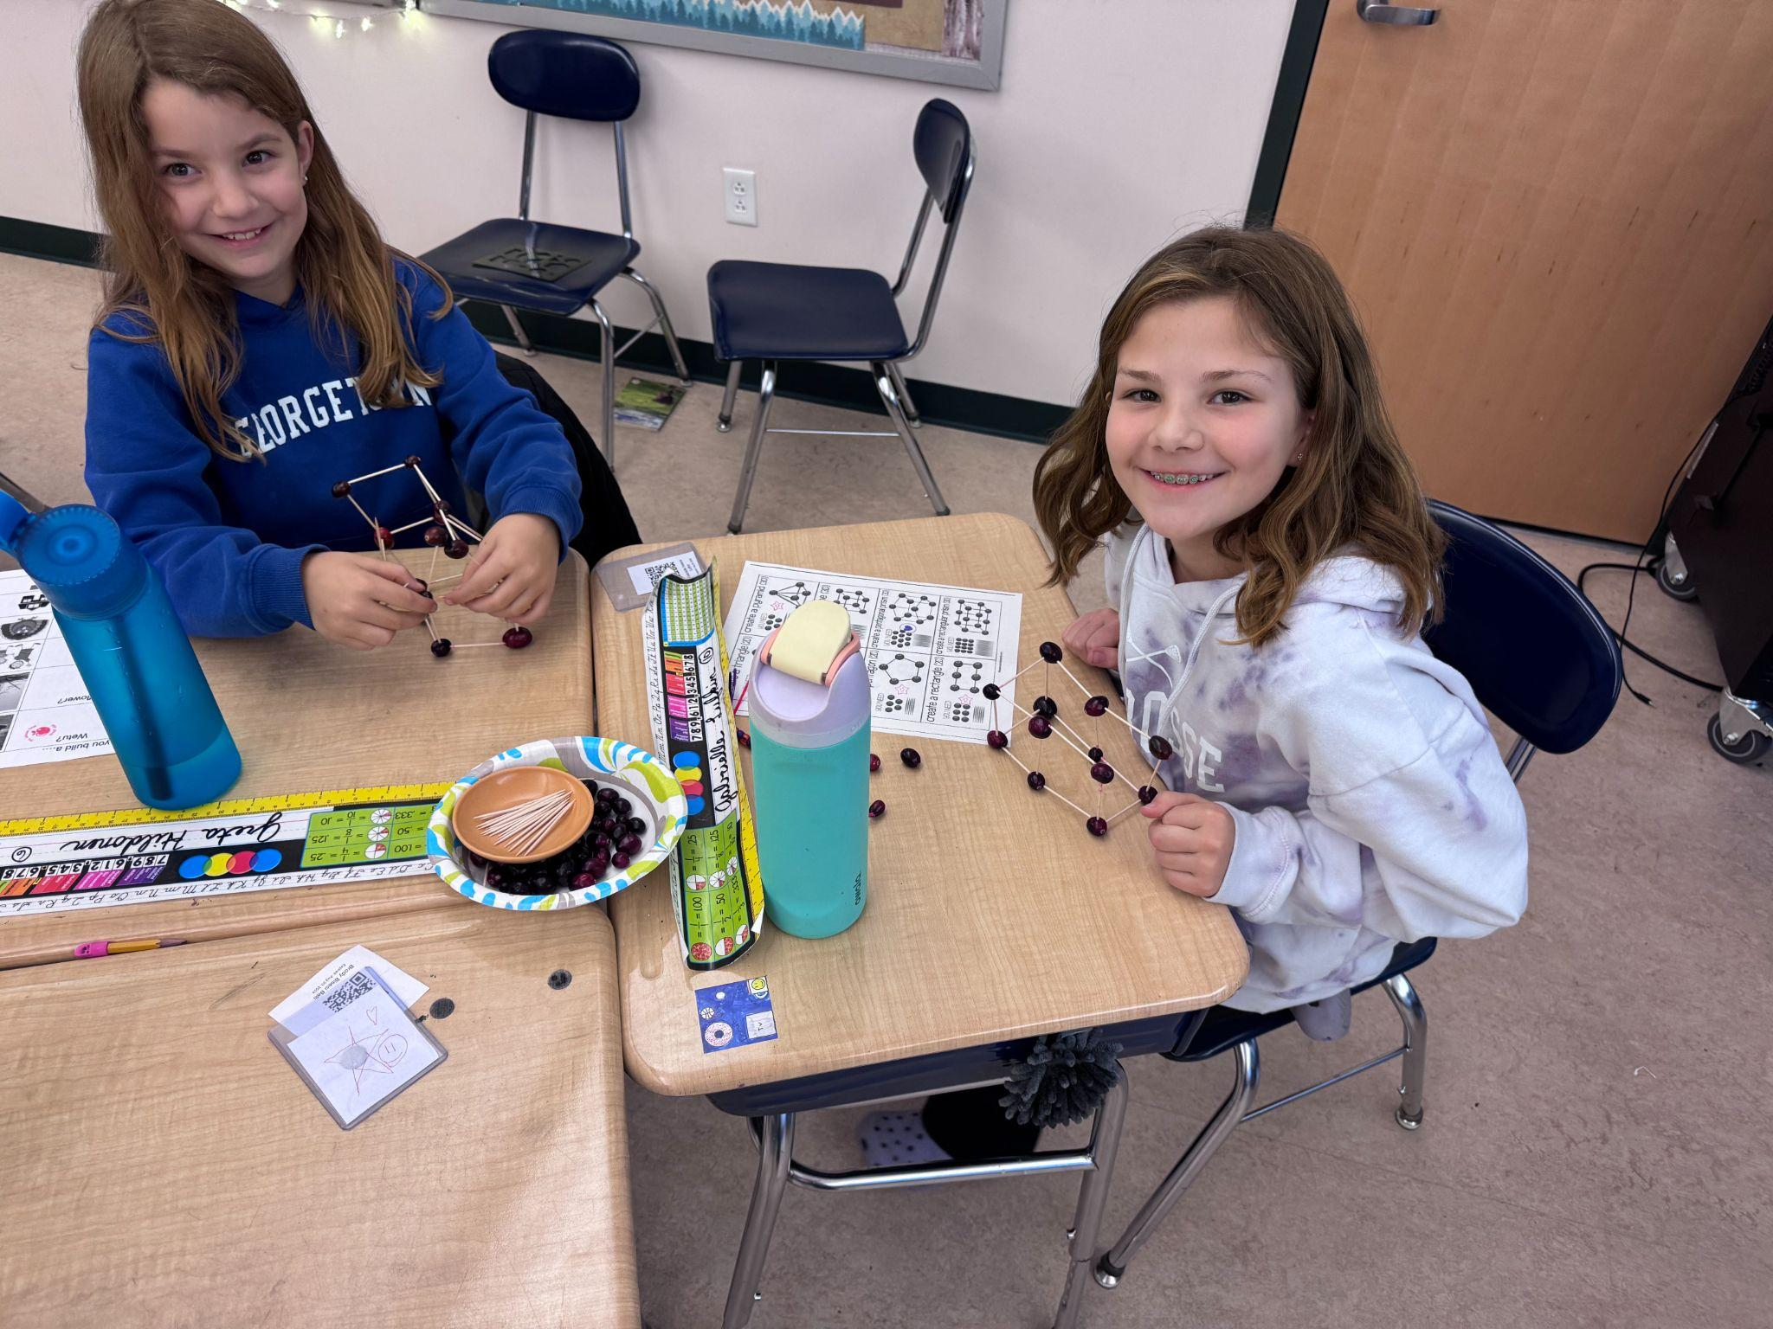
FY26 Impacts
Penn Brook
Maintain current staffing numbers
Develop specialized programming, Thrive, Compass, SSC
4 Part time tutors for targeted intervention and acceleration
GMHS
1 Middle School Behavior Coach
Special Education teacher for increase support for HS Thrive Program, MS Compass and Thrive programs
Creation of a Director of Innovation Learning and Student Supports
Maintains class and Advanced Placements offerings
Fund existing after school clubs at GMHS
Replace aging microscopes & kiln
Athletics
Funding for a full time Athletic Director/Trainer
Funding for fall and winter coaches
Funding for JV Cheerleading and Varsity Boys Volleyball
Funding for equipment & transportation
Notes:
Margo

Slide 6
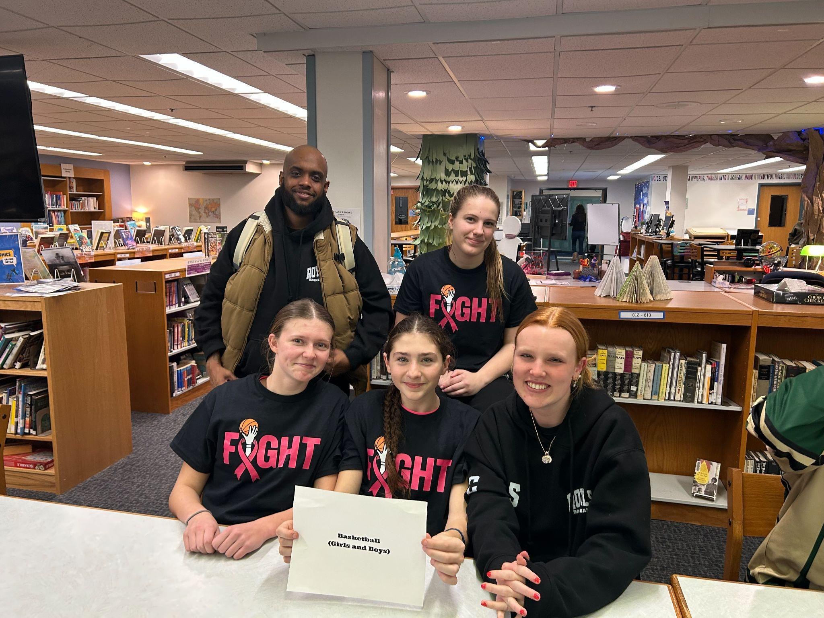
FY27
Funding Sources
Notes:
Mike

Slide 7
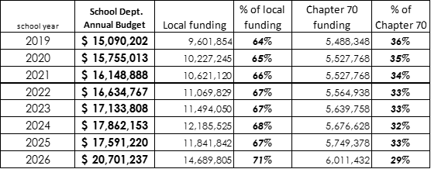
Resources: Chapter 70
Notes:
Mike

Slide 8
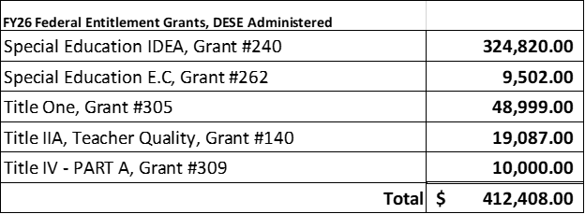
Resources: FY26 Grants
FY26 Federal Entitlement Grants, DESE Administered
Special Education IDEA, Grant #240 324,820.00
Special Education E.C, Grant #262 9,502.00
Title One, Grant #305 48,999.00
Title IIA, Teacher Quality, Grant #140 19,087.00
Title IV - PART A, Grant #309 10,000.00
Total $412,408.00
Notes:
Mike
The district receives five entitlement grants (or non-competitive grants) annually from the Department of Elementary and Secondary Education.
Grant 240 is a federal grant program that provides funds for eligible students with disabilities FUNDS FIVE PARAS
Grant 262 is the Early Childhood Special Education (ECSE) Program Federal Entitlement Grant to help eligible children with disabilities receive a free and appropriate public education. PARTIALLY FUNDS A EC PARA
Grant 305 helps ensure all children receive a high-quality education through academic, instructional, and support services for eligible students. PARTIALLY FUNDS READING TEACHER AT PBES
Grant 140 provides supplemental resources to improve the quality of teaching and leadership, increase student achievement and/or provide equitable access to effective teachers and leaders for low-income and minority students FUNDS PD AND SUPPLIES
Grant 309 helps districts build capacity to help ensure that all students have equitable access to high quality educational experiences. FUNDS PD

Slide 9

Proposed FY27 Superintendent’s Budget
Notes:
Mike

Slide 10
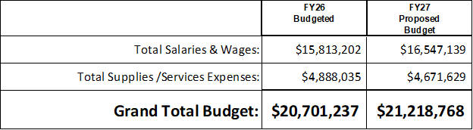
Proposed
FY27 School Department Budget
two & half percent (2.5%) increase
Proposed FY27
Budget
Notes:
Mike
Salaries and Wages are going up 4.64% - step scale, cba salary increases, individual contracts
Supplies and Services went down 4.43%
Overall budget number is increase $517,531 from FY26

Slide 11
Provide a quality public education focussed on HIGH QUALITY STUDENT LEARNING
Preserve student access to a well-rounded educational program
Maintain class offerings at the secondary level
Allocate resources to meet students’ needs
Allocate resources in alignment with the District Strategic Plan to ensure funding for the greatest impact on teaching and learning
FY27
Budget Development Priorities
Notes:
Margo

Slide 12
FY27
Assumptions
FY27 School Department Budget includes:
Projected Custodial and Food Service negotiations
Contractual staff increases: step increases, longevity & degree advancements
Projected increase for out-of-district tuition & transportation costs for our special education students
General education transportation cost increases (four buses)
Notes:
Margo

Slide 13
Penn Brook Elementary School
Director Salary & PK Paraprofessional (fully funded on revolving account)
Literacy Specialist, assisting staff
Literacy Specialist, assisting student
Evaluation Team Chairperson
Georgetown Middle High School
One (1) Van Driver (HS transport)
Computer Teacher, half time
Academic Coach, STEM, 6-12
Academic Coach, Humanities, 6-12
Evaluation Team Chairperson, GMHS
School Adjustment Counselor
Hall Monitor (paraprofessional)
Athletic Coaches, Winter & Spring (fully fund)
FY27 Budget Development-
Where We Started -
Wish List
District Offices
ESY Transportation
Three (3) Driver, Van (OOD)
HVAC position, split with Town
Food Service Director
Goods & Services fully funded
Curriculum
Professional Development
Operations
Technology
Replacement Maintenance Truck
Notes:
Mike

Slide 14
What is New:
ESY Transportation (summer work)
Evaluation Team Chairperson, District (1.0 FTE)
Literacy Specialist, student (1.0 FTE)
One (1) Van Driver, (1.0 FTE)
Reduced Positions
Preschool Teacher (1.0 FTE)
Elementary Grade Level teacher (1.0 FTE)
High School teachers (3.0 FTE)
FY27 Budget-
Where we landed
Notes:
Mike
PreK - shifting to staffing model that will include dually certified PreK Teachers (Early Childhood and special education) We will reduce the special education teacher and increase the paraprofessionals by 1 Model will be 1 teacher and 2 paras
Literacy specialist: Using our early literacy data to identify our students in early elementary that need literacy intervention. When we offer strong evidence based intervention we can catch students early and intervene so they won’t struggle in upper elementary and beyond.

Slide 15
Penn Brook Elementary School
Preschool Program Restructure: Program model will be adjusted to have dually certified PreK Teachers (Early Childhood and Special Education) which eliminates the PreK Special Education Teacher. The program will maintain three (3) classrooms.
The new PreK classroom model will include one (1) teacher and two (2) paraprofessionals, which will result in a new paraprofessional position.
FY27
Budget
&
Enrollment Impact
Notes:
Margo
14 - 15 students per class with 7 students receiving special education services
enrollment numbers have decreased
FY23 82
FY24 88
FY25 71
FY26 46

Slide 16
Penn Brook Elementary School
Reduce Elementary 4th Grade Teacher (1.0 FTE):
Projected School Year 2026/2027 Model:
Grade PK: 3 classes, average class size: 15
(with two designated paraprofessionals in each class)
Kindergarten: 4 classes, average class size: 20 +/-
(with one designated K paraprofessional in each class)
1st Grade: 4 classes, average class size: 21
2nd Grade: 5 classes, average class size: 20
3rd Grade: 4 classes, average class size: 21
4th Grade: 4 classes, average class size: 24
5th Grade: 4 classes, average class size: 22
FY27
Budget
&
Enrollment Impact
Notes:
Margo

Slide 17
Penn Brook Elementary School
One (1) Literacy Specialist: Our early literacy data identifies our students that need literacy intervention. When we offer strong evidence based intervention we can catch students early and intervene so they won’t struggle in upper elementary and beyond.
Current Data: Students who are performing well below grade level and in need for intensive literacy support
16 Kindergarten students (19% )
20 1st Grade students ( 21% )
11 2nd Grade students (14% )
Model Implementation
Evidence based literacy instruction tells us that these students should be learning in small groups (4 or less) or individual support
FY27
Budget
Impact
Notes:
Margo
Building our MTSS model

Slide 18
Georgetown Middle High School
Class Schedule Review: Align content area teachers with the number of current grade level students and support Innovation Programming
Three (3) teachers reduction: Anticipated reduction from a teacher retirement(s) and realignment of schedule
One (1) Van Driver - HS transport: Driver will assist with internships and early college opportunities
FY27
Budget
&
Enrollment Impact
Notes:
Margo

Slide 19
District-wide
One (1) Special Education Team Chair (ETC): Managed by the Director of Student Services will facilitate initial and re-evaluation meetings and work with our teachers on IEP development and supporting annual special education meetings
ESY Transportation: Projected $18,000 budget savings if our current drivers are utilized for summer transportation
FY27
Budget
Impact
Notes:
Margo

Slide 20
Transportation Infrastructure
Continuing the modernization of HQIM, professional development and Multi Tiered System of Support Resources
Purchase Mathematics curriculum for Grades K-5
Utilize local funds to match erate funds for replace obsolete access points in all school buildings
Adding two (2) potential out-of-district tuitions
FY27 Budget
Goods
&
Services
Notes:
Mike

Slide 21

Analyze regionalization/Tuitioning or GHS Redesign and their impacts on the salary & wages, operations and Town budget
Monitor enrollment trends and recruit for HS school choice applicants.
Invest in the Transportation Infrastructure to handle all Out-of-district student transportation, as well as big bus transportation
Prepare for teacher negotiations
during the fiscal year
Partner with the Town to
consolidate operational services,
i.e. HVAC technician
Looking Beyond FY27
Notes:
Mike

Slide 22
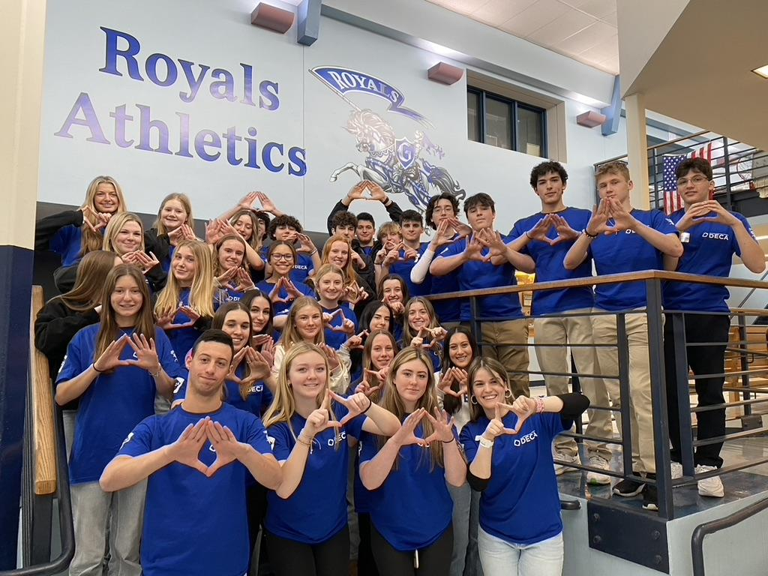
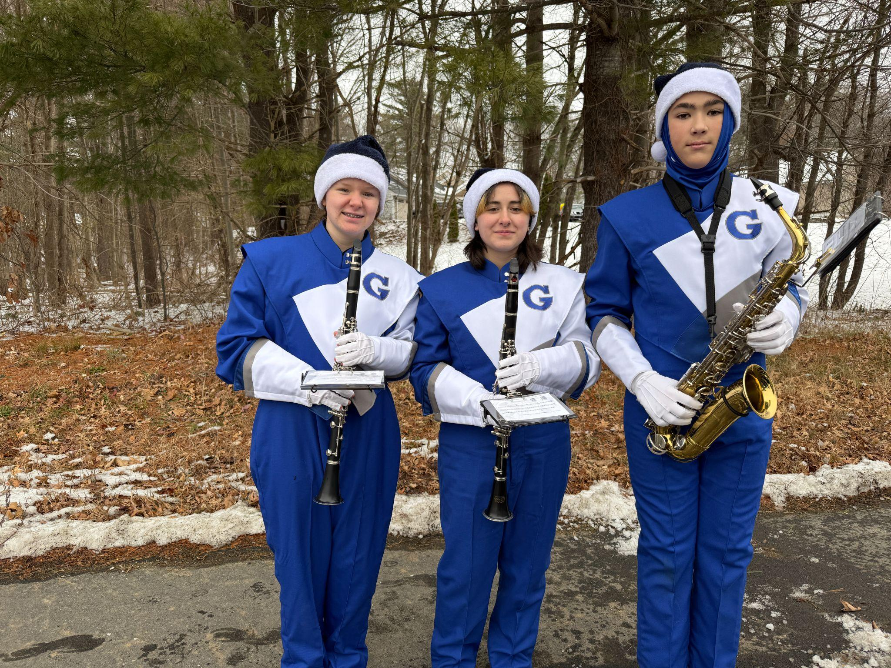
Important Budget Dates and Events
February 12, 2026
FY27 Budget(s) & slides will be posted on website
February 25, 2026
FY27 Budget presented at the Finance Committee
February 26, 2026
Public Hearing with Public Comments on FY27
Budget(s)
March 12, 2026
Recommended Budget, School
Committee Vote
May 04, 2026
Town Meeting
Next Steps

Slide 23
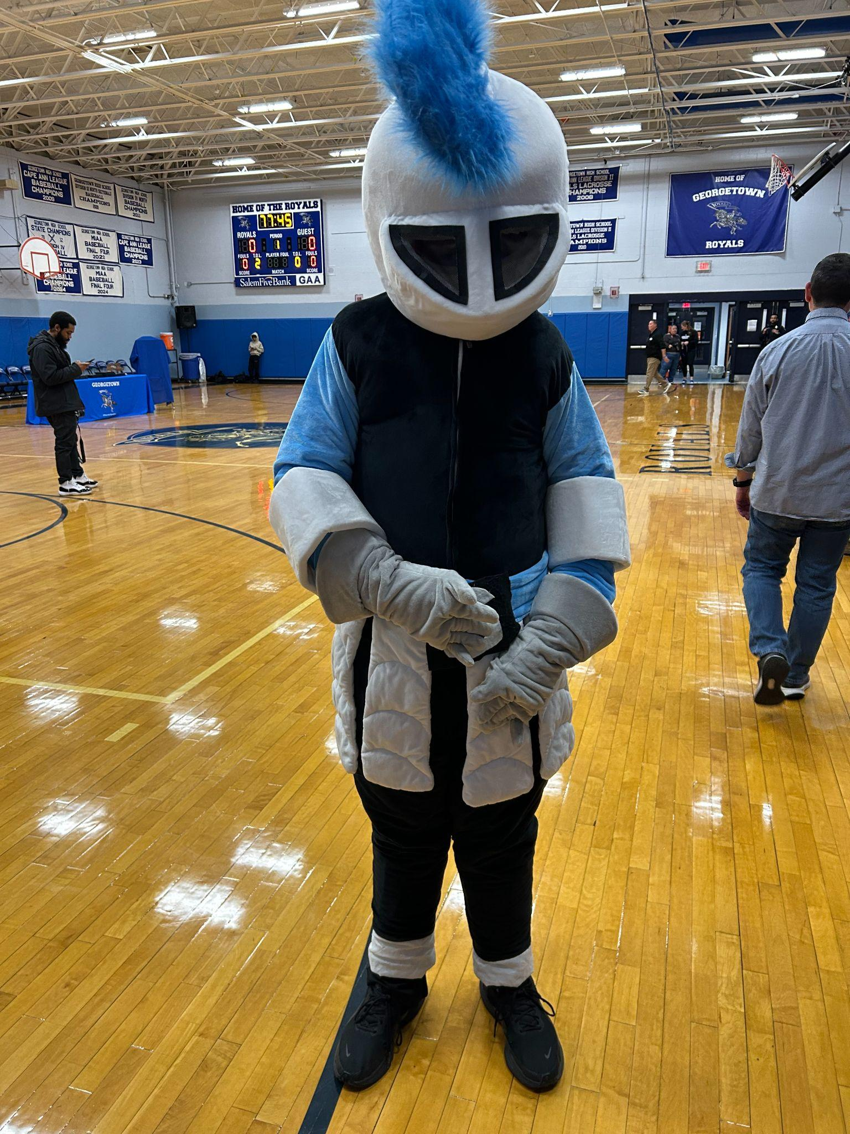
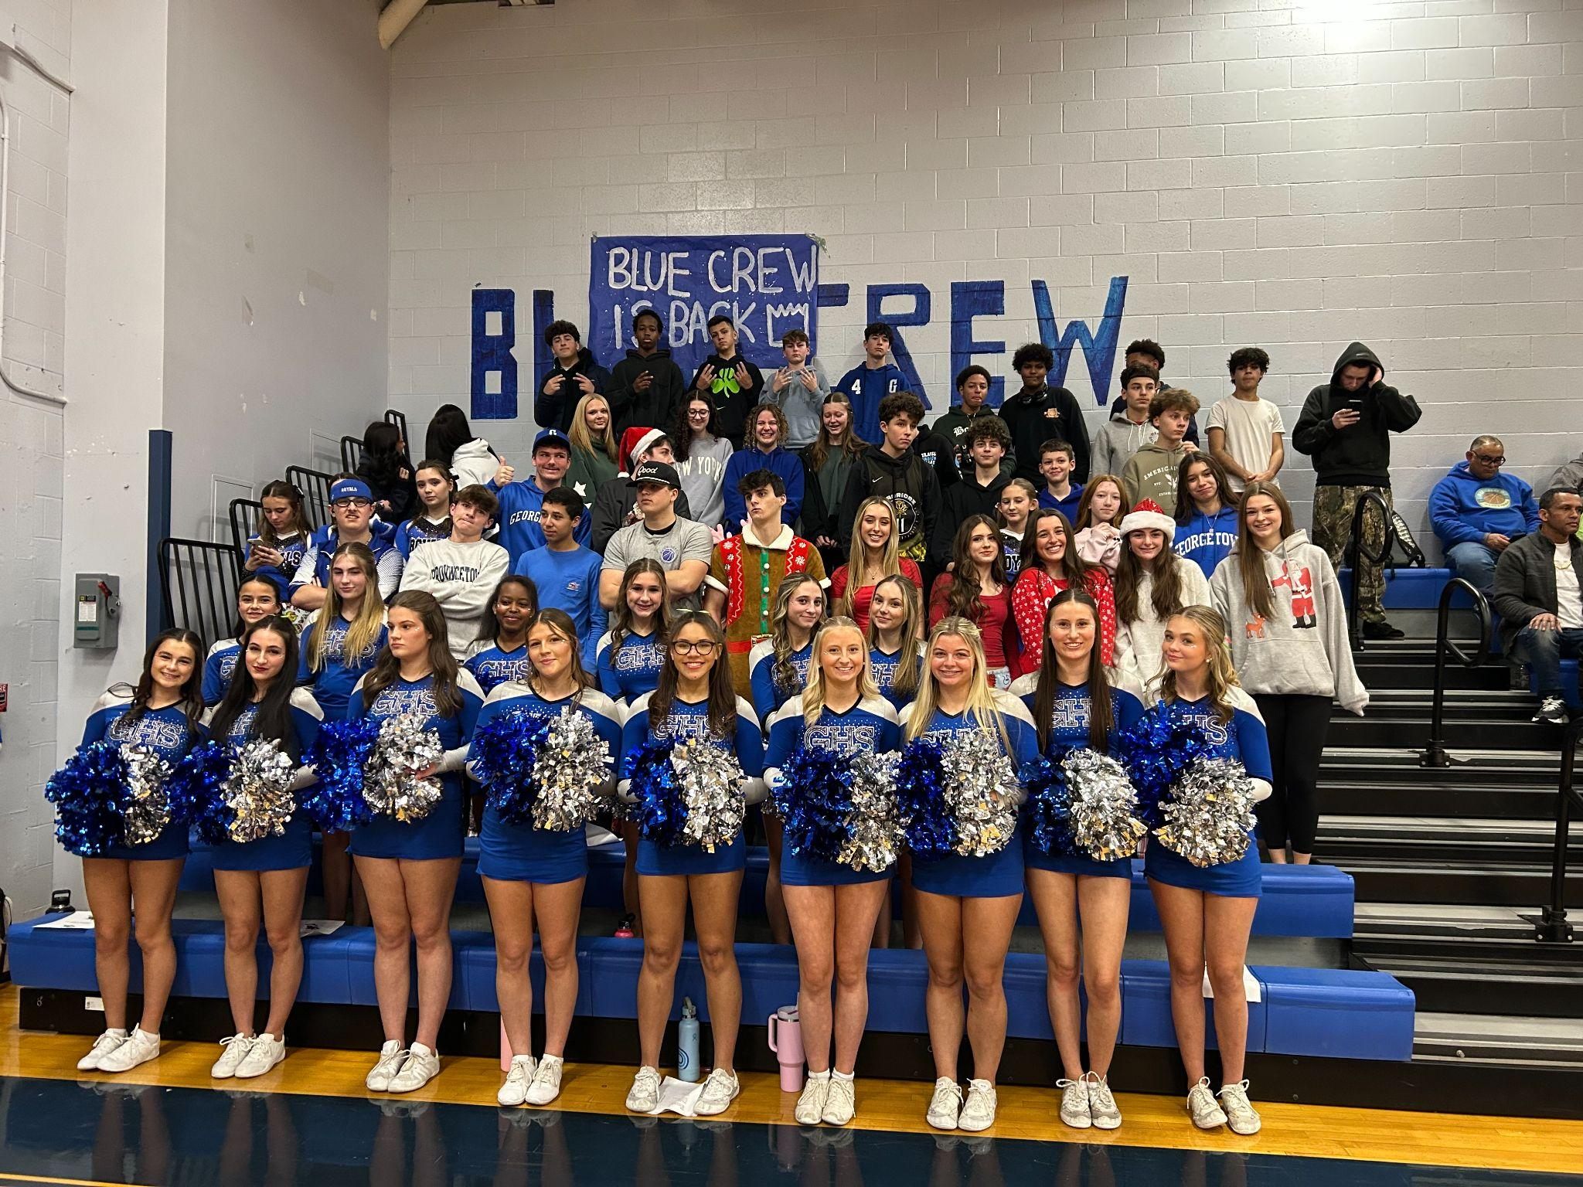
FY25 Budget Impacts
FY25 Budget Impacts
Thank You!

